Slide 1
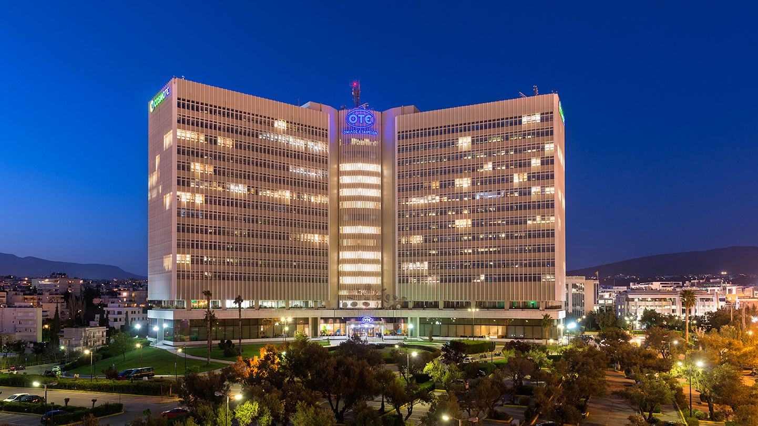






CFA Institute Research Challenge 2019
Markos Zorzos
Kostis Mamais
Giannis Stamatis
Christos Gkitersos
BUY
Makis Dragatsis
University of Piraeus
Department of Banking and Financial Management
Recommendation

Slide 2









Fixed 56%
Mobile 41%
Other 3%
Source: OTE Group
Business Segments

Slide 3
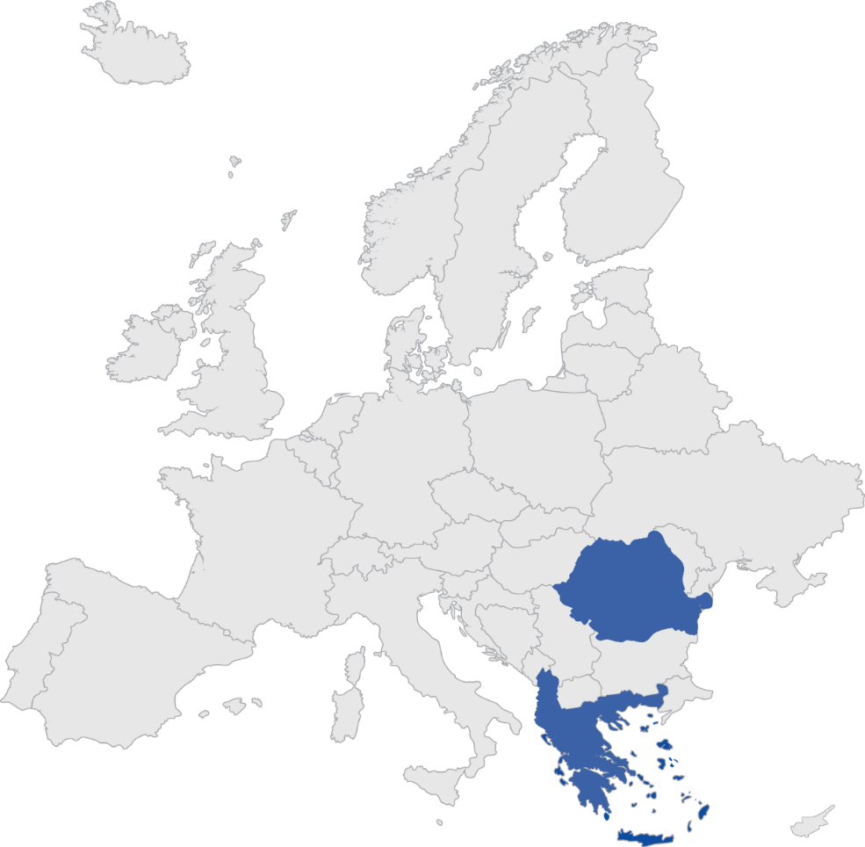
Romania 25%
Albania 2%
Source: OTE Group
Geographical presence
Notes:
Geographical Segments
Χαρτης Ευρωπης και με χρωμα οι χωρες που δραστηριοποιειται ο ΟΤΕ
Στην αναφορα που κανουμε γα την Αλβανια θα φευγει το χρωμα από Αλβανια
Διαγραμμα που θα δειχνει τι ποσοστο εσοδων εχει ο ΟΤΕ από κάθε χωρα

Slide 4

Revenue Sources
Adj. EBITDA
Greece
76%
Greece 90%
Romania 24%
Romania 10%
Source: OTE Group
Geographical presence
Notes:
Geographical Segments
Χαρτης Ευρωπης και με χρωμα οι χωρες που δραστηριοποιειται ο ΟΤΕ
Στην αναφορα που κανουμε γα την Αλβανια θα φευγει το χρωμα από Αλβανια
Διαγραμμα που θα δειχνει τι ποσοστο εσοδων εχει ο ΟΤΕ από κάθε χωρα

Slide 5





BUY
€ 13.68
Recommendation
Closing price: € 12.00
April 1st 2019
14%
upside
Positive reversal of revenues through dominance in the new Fiber technology
Cost optimization and increased EBITDA margin
High FCF generation (CAGR:20%) leads to higher payout to the shareholders
Apr-19
Apr-20
Strong competitive positioning
Increased revenue growth
Solid financial metrics
Upside potential with limited risk

Slide 6











Market shares
Fixed Telephony
Mobile Telephony
OTE voice users
55%
Greece
46%
OTE broadband users
45%
OTE voice users
45%
Romania
OTE broadband users
23%
Source: Companies’ Data
Strong competitive positioning
Increased revenue growth
Solid financial metrics
Upside potential with limited risk

Slide 7





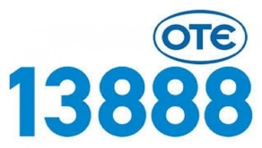
Customer satisfaction
Mobile Internet Speed (in Mbps)
>99%
4G POPULATION COVERAGE
Upload Speed
Download Speed
Source: Companies’ Data
Strong competitive positioning
Increased revenue growth
Solid financial metrics
Upside potential with limited risk

Slide 8



Survey for customer satisfaction in telecommunications
75.2%
believes that OTE is the best telecommunications company in Greece
Percentage of satisfied customers
75%
Competitors
60%
Sample of survey: 347 respondents
Age range: 15 – 60+
Gender: 55.5% male / 44.5% female
Geographic location: Greece
of respondents value quality over price
of OTE’s customers have been loyal in the last 3 years
55%
85%
Source: Team Assessment
Strong competitive positioning
Increased revenue growth
Solid financial metrics
Upside potential with limited risk

Slide 9



Corporate Governance Assessment
Board structure
The election of the BoD is conducted every 3 years, earlier than the 6 years indicated by the law
Peer Group
Average Score B-
No clearly published status of remuneration to BoD members
Audit and compensation committees
66% of the Audit and 33% of the Compensation committee are independent directors
No Nomination Committee for the elections of candidates for BoD members
Shareholder rights
Charters of BoD and Audit committee are published for everyone
The remuneration policy of BoD is not approved by the shareholders
ΑΤΗΕΧ
FTSE 20 Average Score B-
Total score
B+
51%
100%
B-
B
B+
A-
A
A+
Source: Team Assessment, Thomson Reuters
Strong competitive positioning
Increased revenue growth
Solid financial metrics
Upside potential with limited risk

Slide 10








Room for growth in Greece
VDSL and Fiber Penetration
7%
33%
Broadband Penetration
80%
86%
Pay TV Penetration
25%
63%
Giga Byte Consumption per month
0.46
2.4
Smartphone Penetration
63%
69%
Post-Paid/Total Subscribers
36%
50%
Source: EDPR
Strong competitive positioning
Increased revenue growth
Solid financial metrics
Upside potential with limited risk

Slide 11


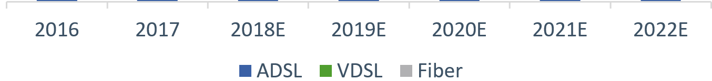
Shift to high-speed broadband
CAGR
of VDSL+Fiber revenues
33.52%
VDSL/Broadband users
Total Broadband Revenues of OTE
2017:
20.13%
Fiber revenues
VDSL revenues
€ In millions
ADSL revenues
2022:
63.21%
CAGR
of ADSL revenues
-14.00%
Source: Team Assessment, EDPR
Strong competitive positioning
Increased revenue growth
Solid financial metrics
Upside potential with limited risk

Slide 12




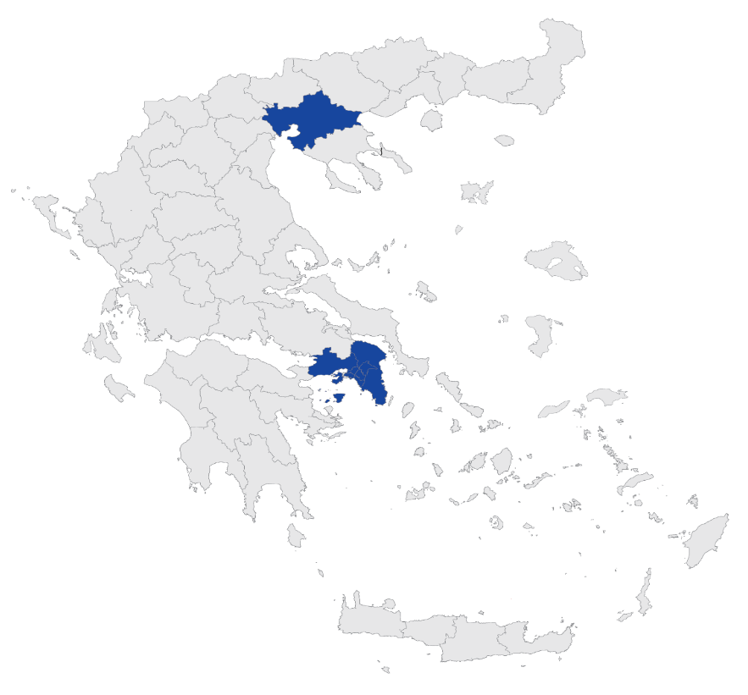











Dominant fiber operator
OTE has invested in areas across all Greece
OTE will have updated 73% of total cabinets by 2019, leaving only 27% to its competitors
OTE has invested in the wealthier areas of Athens and Thessaloniki
Currently, only OTE exploits its cabinets
Source: Team Assessment, EETT
OTE cabinets
Vodafone cabinets
Wind cabinets
Strong competitive positioning
Increased revenue growth
Solid financial metrics
Upside potential with limited risk
Notes:
Χαρτες με καμπινες

Slide 13











Pay TV
Pay TV revenue CAGR 4.35%
Market Shares
55%
45%
Source: Companies’ Data
Strong competitive positioning
Increased revenue growth
Solid financial metrics
Upside potential with limited risk

Slide 14


Mobile revenues
2017
Giga Byte per month
0.46
Smartphone Penetration
63%
€ In millions
2022
Giga Byte per month
1
Smartphone Penetration
73%
CAGR of data revenues: 13.22%
Source: Team Assessment, EDPR
Strong competitive positioning
Increased revenue growth
Solid financial metrics
Upside potential with limited risk

Slide 15

Revenue growth & Cost optimization…
Total Revenues
Cost Evolution
CAGR: -1.22%
€ In millions
€ In millions
Source: Team Assessment
Strong competitive positioning
Increased revenue growth
Solid financial metrics
Upside potential with limited risk

Slide 16
… lead to increased Adj. EBITDA
Adj. EBITDA/EBITDA margin
Increased Revenues
Cost Optimization
€ In millions
Adj. EBITDA CAGR 3.08%
Source: OTE Group, Team Assessment
Strong competitive positioning
Increased revenue growth
Solid financial metrics
Upside potential with limited risk

Slide 17
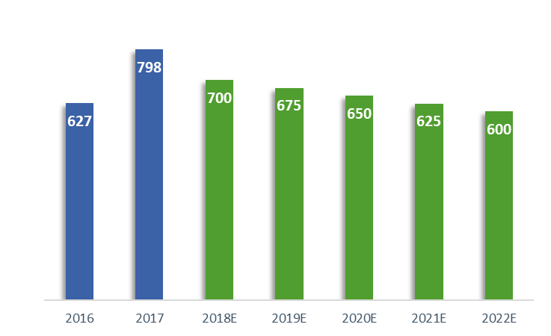








Decreasing CAPEX and low leverage
Adjusted CAPEX
Leverage Among Peers
CAGR: -5.54%
€ In millions
Source: OTE Group, Team Assessment
Strong competitive positioning
Increased revenue growth
Solid financial metrics
Upside potential with limited risk

Slide 18



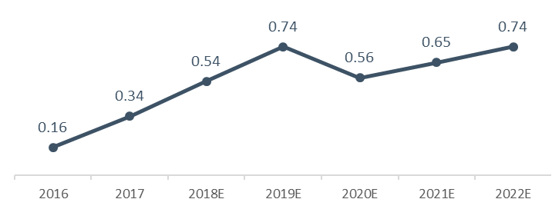
High FCF generation
Free Cash Flows
Dividend Evolution
100%
FCF
CAGR: 19.65%
€
65%
Dividend
35%
Share Buyback
€ In millions
Dividend per share (€)
2017 was a year with very high CAPEX and spectrum expenses, which resulted in negative FCFs
Source: OTE Group, Team Assessment
Strong competitive positioning
Increased revenue growth
Solid financial metrics
Upside potential with limited risk

Slide 19



Blended Valuation
BUY
DISCOUNTED FREE CASH FLOW TO FIRM
MULTIPLE ANALYSIS EV/EBITDA
TARGET PRICE
€13.68
14%
70%
30%
UPSIDE POTENTIAL
Source: Team Assessment
Strong competitive positioning
Increased revenue growth
Solid financial metrics
Upside potential with limited risk

Slide 20



DCF valuation
WACC
DCF Target Price
2018
+
+
9.38%
€13.92
2019 - 2022
+
9.31%
2022 - ∞
7.85%
Cost of Debt
3.36%
+
Terminal Growth
1.60%
Greek MRP
9.02%
Avg. MRP 8.59%
Cost of equity 9.60%
Beta
0.93
Romanian MRP
7.46%
Source: Team Assessment, Damodaran
Strong competitive positioning
Increased revenue growth
Solid financial metrics
Upside potential with limited risk

Slide 21


Multiples valuation
Multiples Target Price
EV/EBITDA Multiple
€13.13
25th Percentile
Median
Source: Team Assessment, Thomson Reuters
Strong competitive positioning
Increased revenue growth
Solid financial metrics
Upside potential with limited risk
Notes:
Multiples Analysis
EV/Ebitda και το target price ΝΑ ΤΟΝΙΣΟΥΜΕ ΤΟ 25TH PERCENTILE
Οπωσδηποτε figure 26

Slide 22
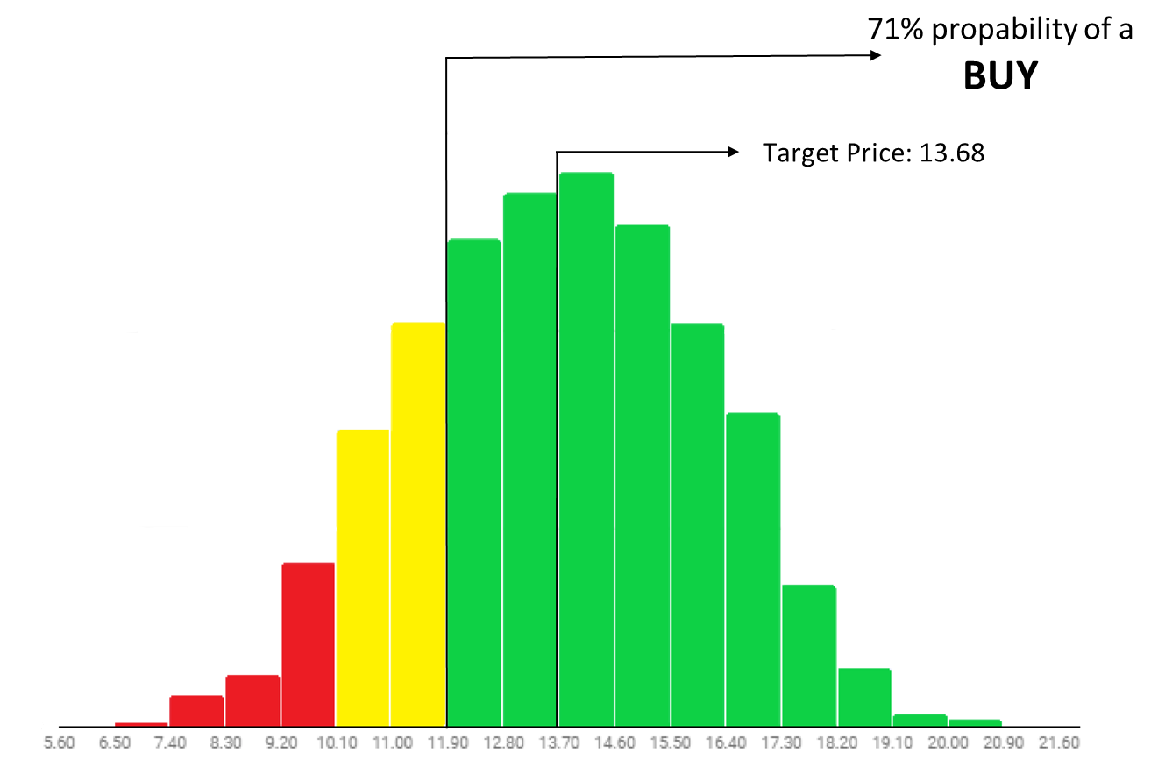
Risks to the target price
Revenues
€
Terminal growth
Personnel costs
Depreciation
Capital Expenditure
Debt
Cash & cash equivalents
Scenario analysis
Sensitivity analysis
Source: Team Assessment
Strong competitive positioning
Increased revenue growth
Solid financial metrics
Upside potential with limited risk

Slide 23
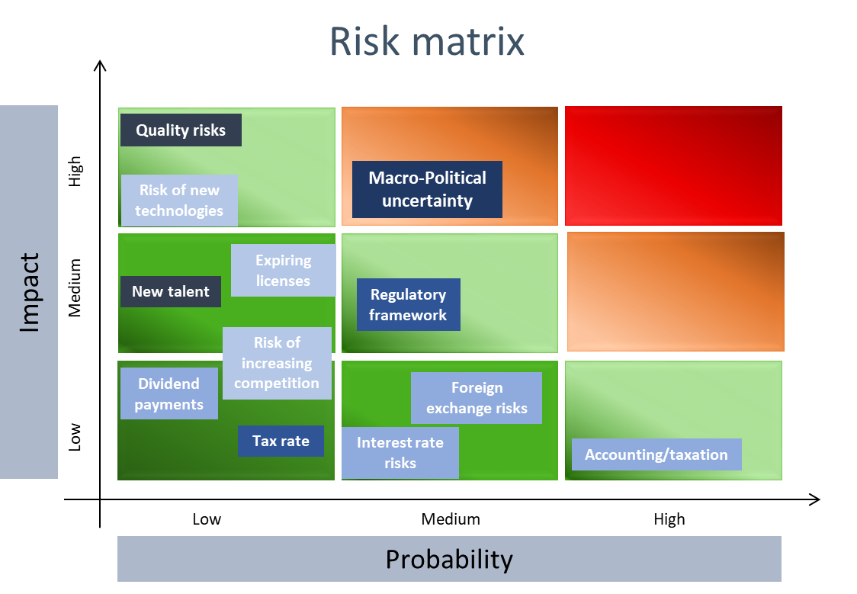
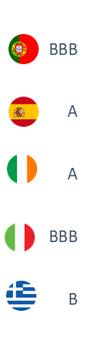
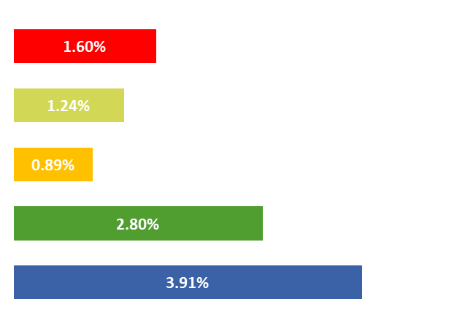

Low Risks Profile
Macro-Political uncertainty
10-Year Government Bond Yield
Strategic Risk Financial Risk Regulatory Risk Operational Risk Other Risk
Source: Team Assessment, World Bank, S&P Ratings
Strong competitive positioning
Increased revenue growth
Solid financial metrics
Upside potential with limited risk

Slide 24
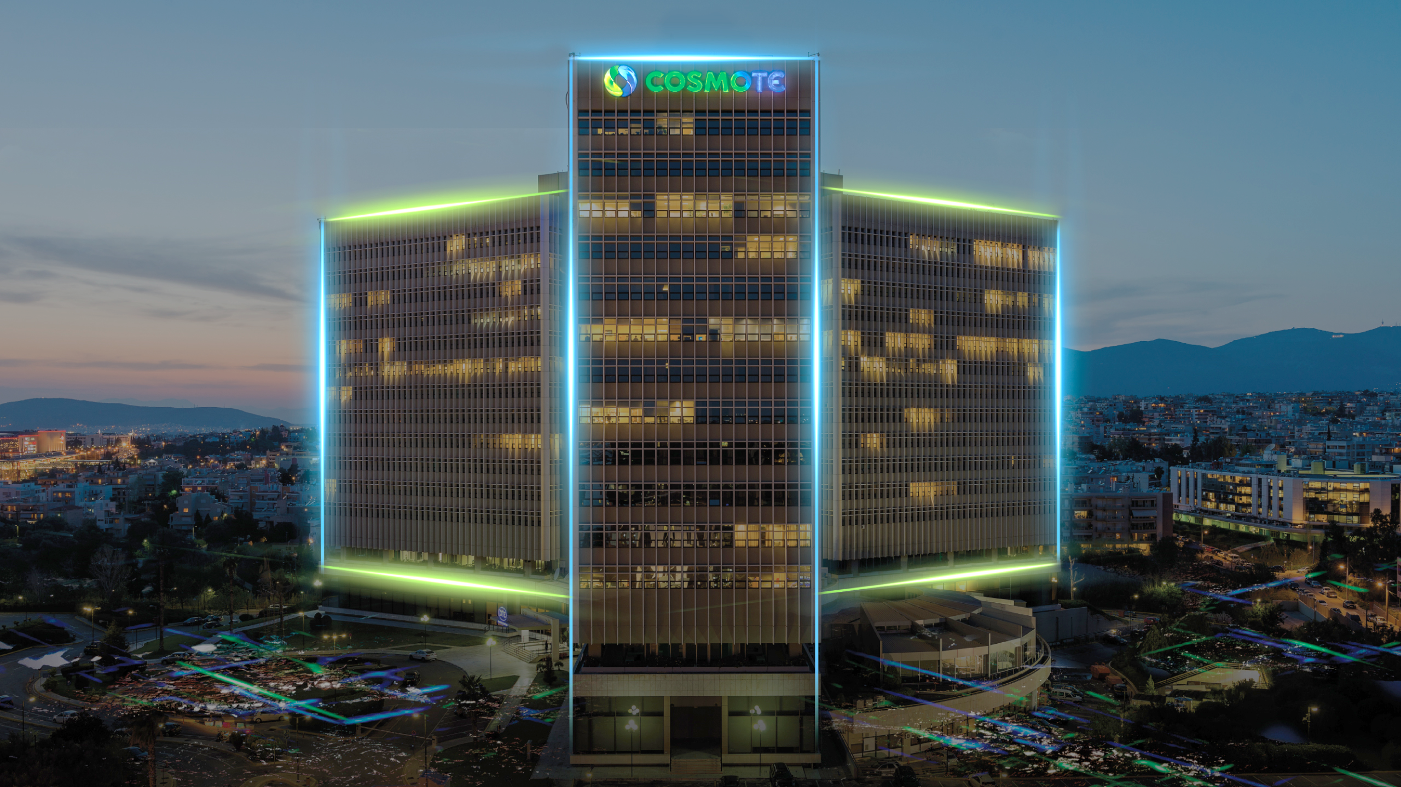


€13.68
Target Price
14%
UPSIDE
BUY
Total 12M Return
with dividends:
€12.00
20.16%
Closing Price
April 1st 2019
RECOMMENDATION
Strong competitive positioning
Increased revenue growth
Solid financial metrics
Upside potential with limited risk
Quality network
Dominant fiber operator
Increased EBITDA margin
Attractive upside
Market leadership
Data consumption
Shareholder value
Limited risk

Slide 25

Distributable FCF
Source: Team Assessment

Slide 26

Sensitivity analysis
Source: Team Assessment

Slide 27





Scenario analysis
€16.91
€13.68
Current Price €10.99
€9.34
Source: Team Assessment

Slide 28
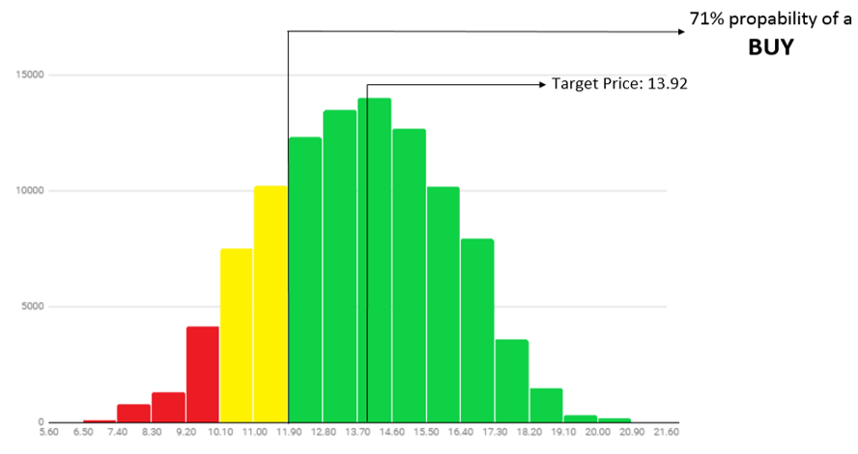


Monte Carlo simulation
Figure 27: Monte Carlo Simulation
€
In our simulation we included variables that are either important for OTE, like its revenues, or consist a large part of its balance sheet like capex and depreciation. The variables included cover each aspect of the Group like liquidity and profitability
Source: Team Assessment
Source: Team Assessment

Slide 29
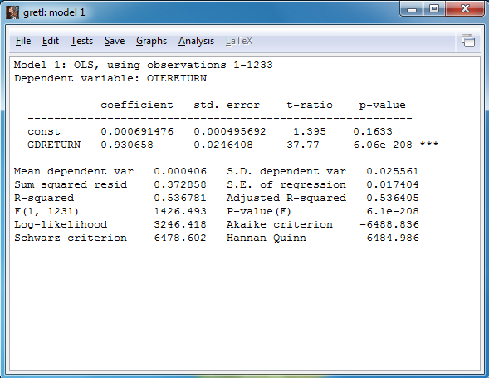
Cost of Equity calculation
CAPM formula: E(R)=Rf + b*Rm
For 2018 the Telekom Albania contribution is included while for 2019 and onwards it was removed from our calculations
For the second stage of our analysis we used a decreased MRP for Greece (11.86% 9.02%)
For the beta we conducted a regression where we used the daily returns of OTE’s stock and ATHEX for the last five years (01/01/14 to 31/12/2018)
Source: Team Assessment

Slide 30
Discounted Cash Flow-Terminal Growth
Terminal growth (g): 1.60%
Initially we used the projections of global organizations for the real GDP growth rates of countries where OTE will have business exposure in the next five years and weighted them into OTE’s geographical revenue proportion
WACC₁(2018-19): 9.38%
WACC₂(2019-22): 9.31%
However, we believe that the 10-year German government bond yield may be more appropriate to reflect the growth of the economy in the long run
WACC₃(2022-∞): 7.85%
Source: OTE Group reports, Team Assessment

Slide 31
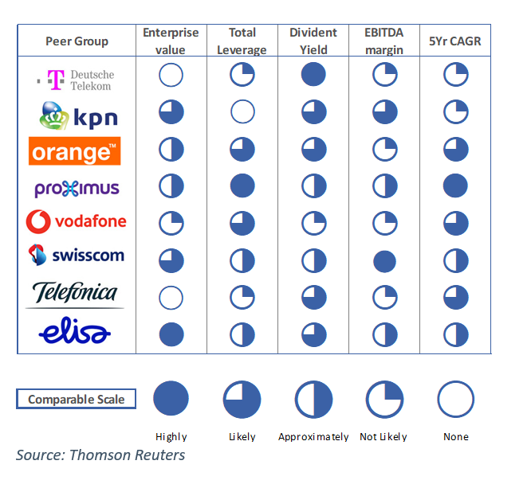
Peers Comparison
It is notable that OTE scores highly in this metric even though it is a smaller company in terms of capitalization
Source: Bloomberg, Thomson Reuters

Slide 32
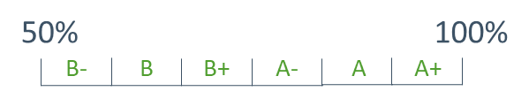
Corporate Governance Assessment
Source: Thomson Reuters, Team Assessment

Slide 33
Ratios comparison
 | 2018E | 2019E | 2020E | 2021E | 2022E
ROA | 1.51% | 2.56% | 3.30% | 4.46% | 5.41%
WACC | 9.38% | 9.31%
ROE | 4.69% | 8.57% | 10.75% | 14.28% | 17.86%
COE | 11.61% | 11.52%
2022-∞
WACC
7.85%
2022-∞
COE
9.60%
We expect ROA to overpass WACC until 2024
Source: OTE Group reports, Team Assessment

Slide 34
Adj. EBITDA margin per segment
Greek Fixed 42.8%
Greek Mobile 33.6%
2017
2022
Romania Fixed 16.8%
Group Consolidated 33.8%
Group Consolidated 38.8%
Romania Mobile 12.5%
Albania Mobile 12.9%
Source: OTE Group reports, Team Assessment

Slide 35
CAGR by segment (2017-2022)
Retail fixed revenues CAGR: 2.55%
-Only voice revenues CAGR : -12.59%
-ADSL revenues CAGR: -14.00%
-VDSL revenues CAGR: 30.76%
-VDSL + Fiber revenues CAGR: 33.52%
-Pay TV revenues CAGR: 4.35%
Mobile revenues CAGR: 1.58%
-Revenues from voice+sms CAGR: -4.02%
-Data revenues CAGR: 13.22%
Wholesale fixed revenues CAGR: -2.57%
Fixed revenues CAGR: -2.44%
Mobile revenues CAGR: -1.55%
Mobile revenues CAGR: -6.42%
(if it had stayed with OTE until 2022)
Operating expenses CAGR: -1.21%
Personnel costs CAGR: -4.92%
Peer group average revenue CAGR (2013-18): -0.3%
Source: Team Assessment

Slide 36

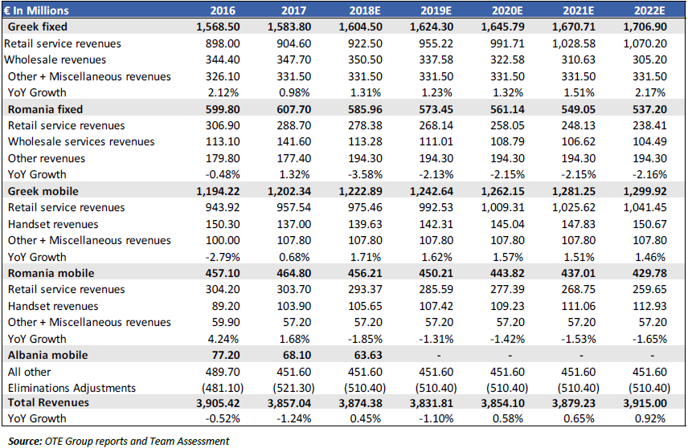
Revenues by Segment
Source: OTE Group reports, Team Assessment

Slide 37
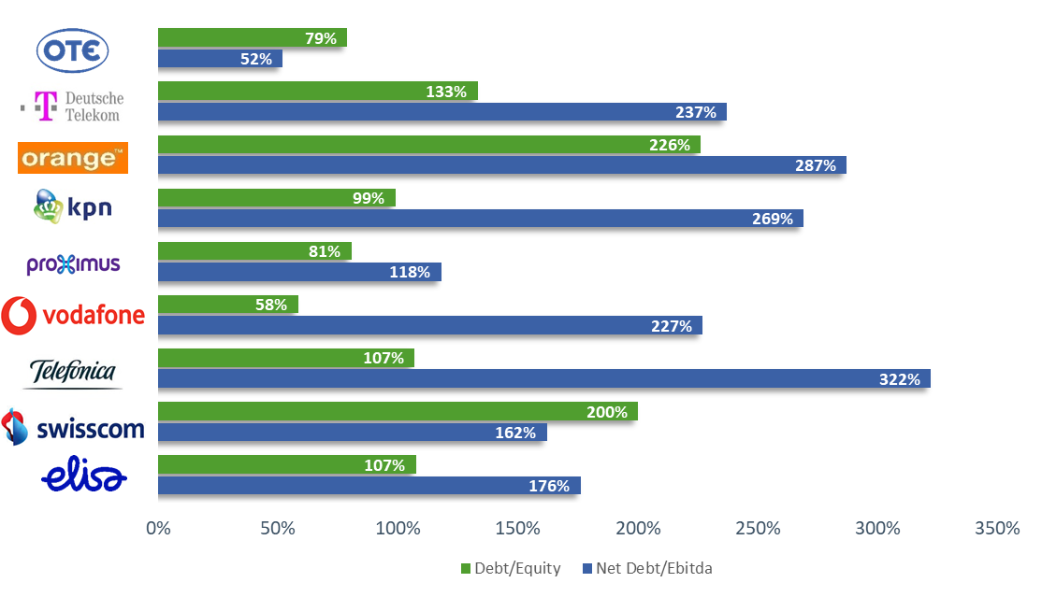
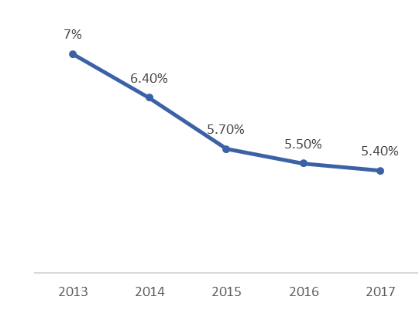
Leverage key points
Cost of Debt evolution
OTE has significantly lower leverage ratios compared to the peer group
Credit rating of OTE: Ba2
Credit rating of Greece: B1
Source: Companies reports, Moody’s

Slide 38


Telekom Romania struggles
Revenues in Romania
Fierce competition
Lack of regulation
Price war
Network overlapping
€ In millions
CAGR for 2017-2022
Fixed CAGR: -2.44%
Mobile CAGR: -1.55%
Total revenue CAGR : -2.05%
Source: Team Assessment

Slide 39

Balance sheet
Source: OTE Group reports, Team Assessment

Slide 40

Income statement
Source: OTE Group reports, Team Assessment

Slide 41
Cash flow statement
Source: OTE Group reports, Team Assessment

Slide 42
Financial and peer ratios
Source: OTE Group, Team Assessment, Thomson Reuters

Slide 43





Wholesale revenues
CAGR:
-2.57%
€1.53
€5.85
ADSL
€ In millions
€12.50
€5.85
VDSL
€ 0.12 of the LLU fee per year
Copper rental fee
Fiber rental fee
Source: OTE Group, Team Assessment

Slide 44
Presentation
Business Segments
Market Shares
Room for Growth
Revenue growth-cost
Valuation
Geographical Presence
Customer Satisfaction
Shift to high speed
Adj. EBITDA
DCF Valuation
Why BUY?
Survey
Dominance in fiber
Capex & Leverage
Multiples Valuation
Corporate Governance
Pay TV
FCF & Dividends
Monte - Carlo
Mobile Revenues
Risks
Backup slides
Distributable DCF
Cost of Equity
ROE - COE
Romania Struggles
Income Statement
Sensitivity Analysis
DCF – Terminal Growth
Adj. EBITDA per seg.
Revenues by segment
Cash Flow Stat.
Scenario Analysis
Peers Comparison
CAGR per seg.
Income Statement
Financial and peer ratios
Monte - Carlo
Corporate Governance
Leverage
Balance Sheet
Wholesale Revenues

