Slide 1
Equity valuation:
Topic 7: Equity Research – A practical perspective

Slide 2
Equity valuation
Equity research: more art than science…?

Slide 3
Fundamentals matter…
ASE index member returns (in %) since 2010

Slide 4
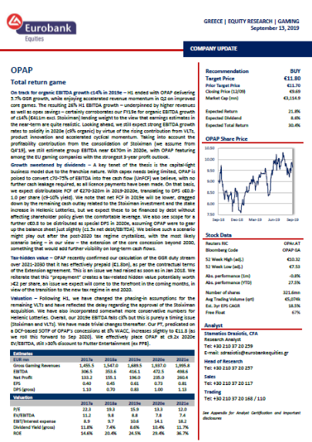
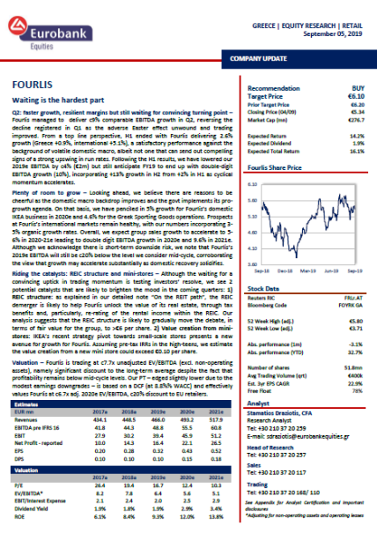
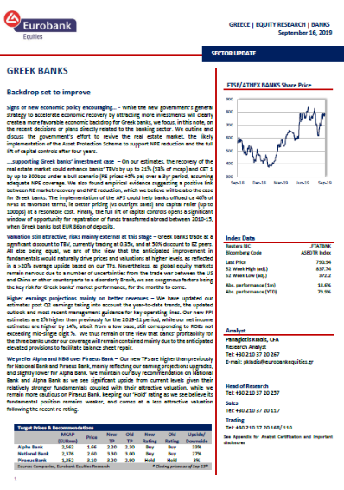
Why is equity research useful...?
Much more than producing a report and coming up with a valuation…!
Vital role in capital markets:
Price formation
Establish market context, e.g. consensus for earnings
Establish valuation context, both absolute and relative
Contribute to the market efficiency by disseminating information and managing investor expectations
Events and announcements would be a surprise otherwise, increasing equity volatility!!!
New issuance and access to capital
Open and “researched” markets usually have higher levels of valuation (and liquidity) → lower cost of capital, easier access of firms to capital
  E.g. think of firms in emerging markets wishing to list in London instead of their home market
Equity research provides insight into the long-term potential of companies which may be currently loss-making → balance risk vs. reward
Promotes growth of the economy by reducing dependence on bank financing

Slide 5
The role of the analyst
Provide information and sector/market insight
Stimulate ideas
Stock picking and safeguarding alpha for buy side investors
Communication with clients
Marketing of ideas
“We are not buying recommendations, i.e. buy/sell Vodafone, and then measuring whether it was a good or bad decision. It’s the process behind that.”
“Some want a clear investment conclusion, whereas others say ‘that’s my job’.”
Fund managers often deny paying attention to buy and sell recommendations…

Slide 6
The day-to-day
Research
Modelling, numerical exercises
External client communication (ad-hoc requests, proactive calls/emails)
Writing
Internal client communication (e.g. sales)
Reading
Company meetings
Roadshows
Dealing with news flow
→ news flow is not research!
No day is the same as the others…

Slide 7
The attributes
Key attributes for success
Self-motivation: take initiatives, come up with new ideas, think out-of-the-box and, ultimately, help clients generate alpha
Focus: given the multiple distractions and flow of data that an analyst is faced with every day, staying organized and focused on the information that matters is a key trait for success
Other important skills
Skepticism: Good analysts rarely accept anything at face value. Never fully trust management teams
Keeping it simple: Simple models, well-presented thesis and easy-to-understand messages in research reports
Soft skills
Communication: distill information into a clear and understandable message, convey complex messages during client roadshows
Confidence: but don’t overdo it…
Empathy: be aware of the clients’ perspective so that you can better cater to their needs and get the most out of the business relationship

Slide 8
So what about the most obvious traits?
Excel and modelling: Obviously important, but you don’t need to be an expert. Just understand basic concepts and avoid mistakes
  Assumptions vs. outputs
  Formulas vs. inputs
  Cross checking
Valuation skills: Again, basic concepts are required. Key is to identify the right valuation methodology and come up with assumptions that make sense!!!
Accounting skills: Financial statement analysis concepts are necessary, as are relevant concepts (cash conversion cycles, return on capital etc.).
  Most important is to be able to identify (or suspect) accounting shenanigans.
Writing skills: Research reports are not PhD theses…
  Need to be punchy
  Have specific message → aimed to help the investor make an informed decision and take action on a stock

Slide 9
Red flags?
It’s all about the cashflow!

Slide 10
A few more words about valuation…
This is where you add value as an analyst, not the WACC calculation..!!!
Where is the analyst value?
e.g. Valuation of the following retail company
Main assumptions presented
Company C
 | 1 | 2 | 3 | 4 | 5 | … | 10 | Term
Sales | 415.2 | 446.7 | 472.7 | 493.5 | 513.2 |  | 614.1
ROIC (post tax) | 5.1% | 6.6% | 8.7% | 10.2% | 10.3% |  | 12.3%
NOPAT | 14.5 | 19.0 | 24.8 | 28.8 | 29.3 |  | 39.0 | 32.7
Depreciation | 13.6 | 14.0 | 14.3 | 14.6 | 15.2 |  | 18.2
Working Capital | (6.1) | (1.1) | (1.1) | (2.5) | (8.0) |  | (9.6)
Capex | (18.1) | (11.1) | (10.3) | (10.3) | (11.5) |  | (17.6)
Free Cash Flow | 3.9 | 20.8 | 27.7 | 30.5 | 24.9 | … | 30.0 | 29.1
PV | 163.5
PV of terminal value | 146.7
Enterprise Value | 310.1
Net debt/other adj. | (80.1)
Equity value | 230.0
# shares (mn) | 51.3
Value per share | 4.5
Implied 12-month value | 5.0 €
Source: Eurobank Equities Research
WACC
Equity Risk Premium |  |  | 5.00%
Risk Free Rate |  |  | 1.50%
Unlevered Beta |  |  | 1.2
Levered Beta |  |  | 2.1
Cost of Equity (adj.) |  |  | 14.56%
Adjustment to COE |  |  | 2.50%
Cost of Debt |  |  | 5.5%
Debt Premium |  |  | 0.00%
Tax Rate |  |  | 24.0%
Adjusted Cost of Debt |  |  | 4.18%
Debt/(Equity + Net Debt) |  |  | 50%
Equity/(Equity + Net Debt) |  |  | 50%
Weighted Cost of Equity |  |  | 7.28%
Weighted Cost of Debt |  |  | 2.09%
WACC (%) |  |  | 9.37%
Calculating the terminal value
Assumed terminal growth |  | 0.5%
NOPAT |  | 32.7
Assumed reinvestment rate in perpetuity |  | 11.0%
Implied FCF in terminal year |  | 29.1
Implied additional investment |  | (3.6)
Return on capital in perpetuity |  | 4.5%
If return on capital = cost of capital, reinvestment rate would be |  | 5.3%
Terminal Value sensitivity analysis
Perpetuity growth
WACC | € 5.0 | -1.5% | -0.5% | 0.5% | 1.5% | 2.5% | 3.5%
 | 6.4% | 6.7 € | 7.4 € | 8.2 € | 9.5 € | 11.3 € | 14.5 €
 | 7.4% | 5.8 € | 6.2 € | 6.8 € | 7.6 € | 8.8 € | 10.5 €
 | 8.4% | 5.0 € | 5.3 € | 5.8 € | 6.3 € | 7.1 € | 8.1 €
 | 9.4% | 4.4 € | 4.6 € | 5.0 € | 5.4 € | 5.9 € | 6.6 €
 | 10.4% | 3.9 € | 4.1 € | 4.3 € | 4.6 € | 5.0 € | 5.5 €
 | 11.4% | 3.4 € | 3.6 € | 3.8 € | 4.0 € | 4.3 € | 4.6 €
 | 12.4% | 3.0 € | 3.2 € | 3.3 € | 3.5 € | 3.7 € | 4.0 €
Source: Eurobank Equities Research.

Slide 11
The challenges
Generate ideas
  Effectively help clients generate alpha
Differentiate and stand-out
  E.g. anti-consensus calls
  Transformation of products (e.g. many published research reports opining on same stocks and market developments)
  Provision of scarce, time-sensitive, and customized services
Unbundling of fees (MIFID II) and other regulatory disruptions
  Spending on research declining
  Limitation on the number of research providers used by asset managers
  Need reinvention of equity research as a profit-making center (e.g. issuer sponsored research?)
Adopting new technologies to generate novel investment ideas and lower costs
  E.g. Leverage AI to interpret high-frequency market data in real time, patterns in supply and demand chains, data in social media.
Shift from active management to quantitative and passive strategies
  Role of analysts less relevant

Slide 12
AI and research
AI will commoditise the tools — not the judgement
  AI will excel at:
  Aggregating information and summarising disclosures
  Building and updating models in real time
  Running scenarios and sensitivities at scale
  As a result, technical execution will no longer be the bottleneck. The bottleneck shifts to interpretation.

Slide 13
Where analysts can still differentiate
Edge will come from:
Seeing what others miss: identifying non-obvious drivers (pricing power, regulatory shifts, capital allocation inflections)
Interpreting what others misread: challenging consensus narratives and understanding second-order effects
Questioning assumptions: not “what happens if true”, but “where does this break”
Framing the right debate: defining what actually matters for valuation, not just what is easy to model
Having conviction: being willing to diverge from consensus when evidence supports it
AI will commoditise Excel.
It will not commoditise judgement, scepticism and variant perception.

Slide 14

Thank you!
s.draziotis@gmail.com

